Slide 1
SPATIAL AUGMENTED REALITY
PROJECTION - BASED

Slide 2
Spatial Augmented Reality
+
Physical Object
Digital Information
Physical Space

Slide 3
Display location: Body vs Space
Retinal
Display
Head-worn
Helmet
Augmented
object
Light path
Hand-held Display
See-through window in space
ON BODY
(A.K.A. See-through)
SPATIAL
(Actual See-Through)

Slide 4
So, spatial only means «not on the user » we do projector-based (S)AR

Slide 5
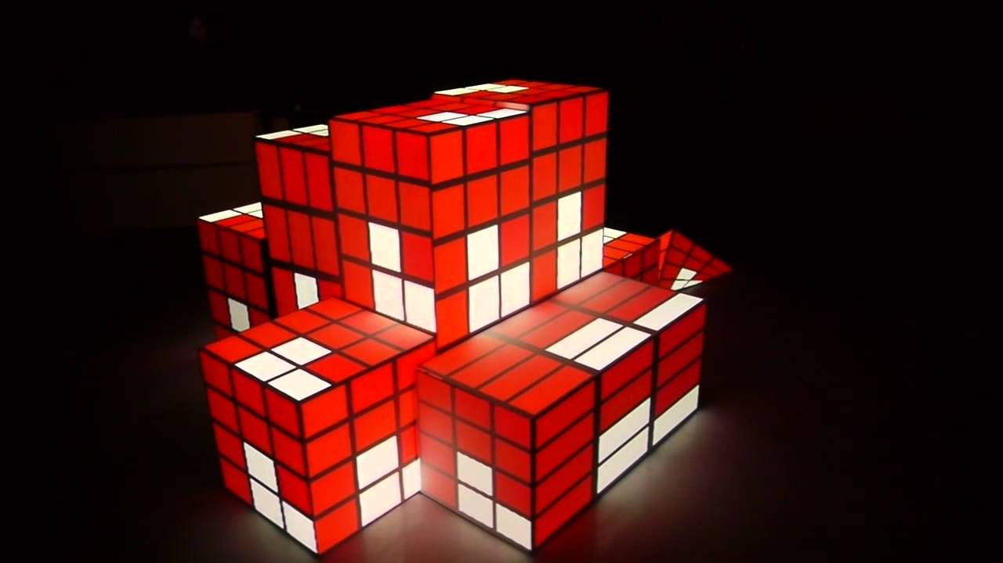
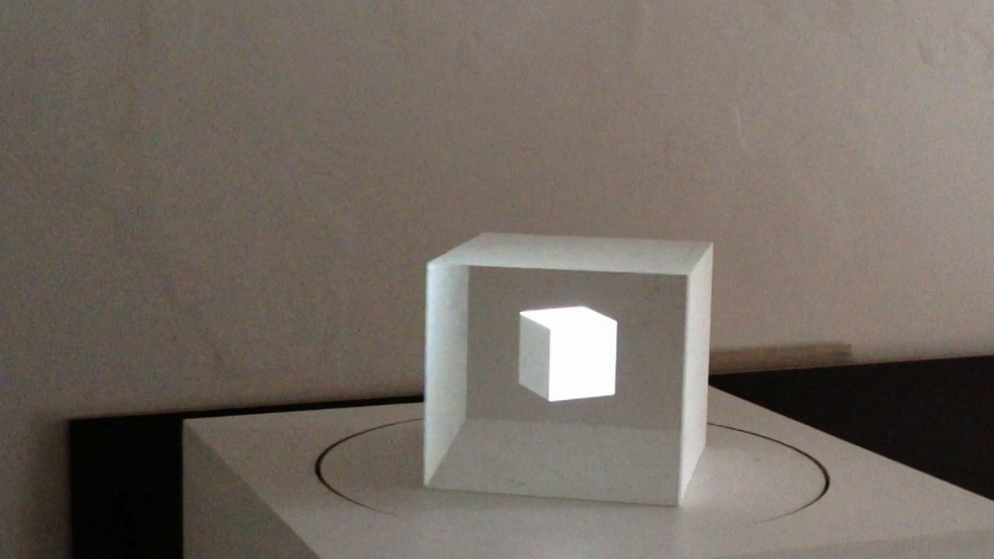
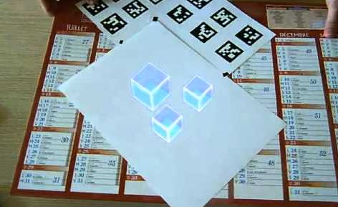
Physical-Digital relationship
+
=
+
=
Texture mapping (Physical geometry == Digital geometry)
Anamorphic illusions (Physical geometry != Digital geometry)

Slide 6
Image location: co-located
Surface
augmentation
User’s eye
Physical
object
Virtual
object
User’s FoV

Slide 7
Image location: virtual behind of physical
See-through
image
User’s eye
Virtual
object
Physical
support
User’s FoV

Slide 8
Image location: virtual in front of physical
Virtual
object
User’s eye
“shadow”
User’s FoV
Physical
support

Slide 9
Image location: virtual in front of physical
Virtual
object
User’s eye
Anamorphic “shadow”
User’s FoV
Physical
support

Slide 10
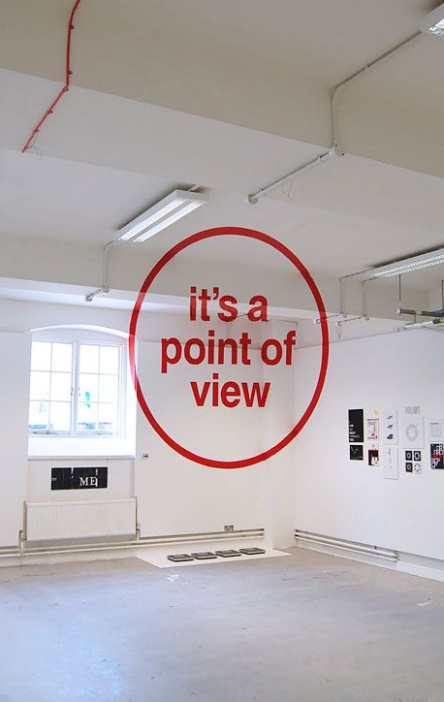
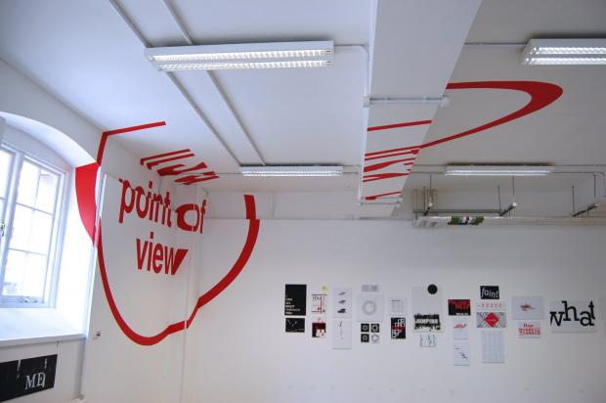
Image location: virtual in front of physical

Slide 11
Stereoscopy
Window
Physical support or Focal plane
Left eye location
Right eye location
Stereo eyewear
Left eye location
Right eye location

Slide 12
Depth error
Virtual behind screen
Virtual in front of screen
Virtual object
Physical object
Depth
error
Depth error
Virtual
object
Monoscopic Display
Virtual
object
Focus distance
Depth
Depth
Vergence distance
Virtual object
Stereoscopic Display

Slide 13
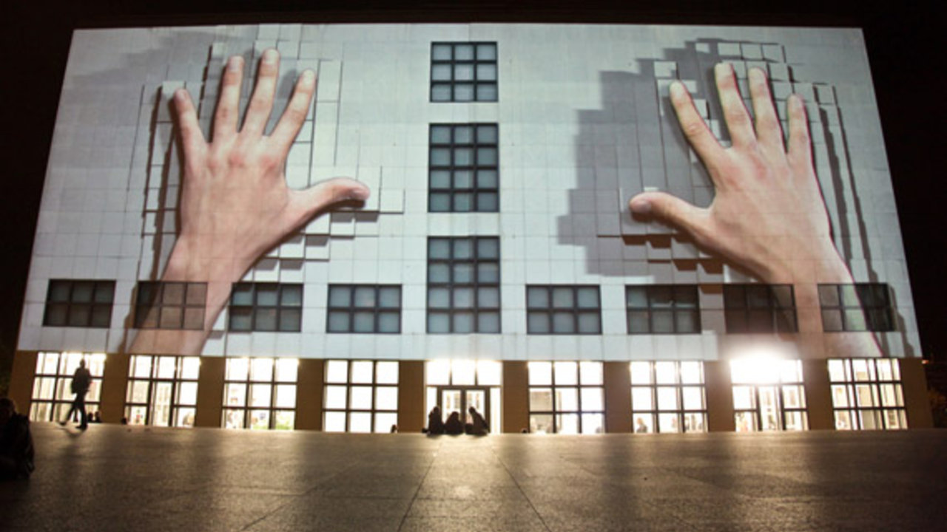

Slide 14
Each of these illusions can be created using projectors

Slide 15
Virtual object
Virtual object
Virtual object
Flat
screen
Arbitrary
screen
Object
Projector
Projector
Projector
User’s eye
User’s eye
User’s eye
1
Surface
Augmentation
2
Flat
Window
Arbitrary
Window
3

Slide 16
Optical devices
(cameras and projectors)

Slide 17
The pin camera model: The parts
Looking at the world, from a point, through a window
The world behind the window (everything, and in this case a cube)
Window (image plane)
World element
Principal point (image center)
This is you, looking at the world through a window
You (Optical center)

Slide 18
The pin camera model: the Field of view
World element
(X,Y,Z)
(U,V)
(Optical center)
(image plane)

Slide 19
The pin camera model: The Frustum
Frustum
The view and perspective of the camera
Things inside are visible, things outside are not
Far plane
World element
(Optical center)
Near plane

Slide 20
The pin camera model: The Depth
The depth is the distance to the object (normalized between near and far planes)
Frustum
Far plane
Depth
World element
(X,Y,Z)
(U,V)
(Optical center)
Near plane

Slide 21
Knowing the camera parameters
PROJECTION
(Shape of the Frustum)
FAR plane
Screen
World element
VIEW
(Camera position and orientation)
NEAR plane

Slide 22
How do these matrices look like?
Coordinate System
3D model
Picture
Calibration
Intrinsics
Extrinsics
Transform from View space to Screen space
Transfrom from World space to View space
Transfrom from Local to World space
Point in
local space
Point in
Screen space
=
Image(2D*)
View(3d)
World(3d)
Local(3d)

Slide 23
How do these matrices look like?
Coordinate System
3D model
Picture
Calibration
Intrinsics
Extrinsics
4x4 matrix normalized space to pixel, then divide by perspective
4x4 matrix (camera transform)⁻¹ as Affine transform (rotation, translation scale)
4x4 matrix
Object transform as affine transform (rotation, translation scale)
X Y Z
U, V (,Depth)
=
Image(2D*)
View(3d)
World(3d)
Local(3d)
One free variable, non-injective Rendering optionally shows what is nearest Stereo cameras intersect vectors

Slide 24
Implementing (S)AR in Unity3D
(all the examples are online at https://github.com/joansolroo/Unity3D.EmguCV)

Slide 25
Pin hole model for see-through

Slide 26
Changing the camera and the image plane
Virtual element
1
WINDOW
World element
CAMERA POSITION
2

Slide 27
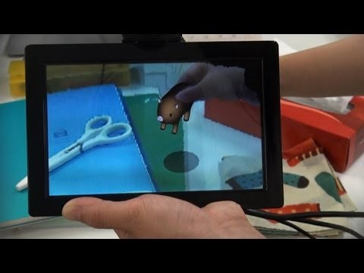
See-through – fixed camera
https://www.youtube.com/watch?v=-iyPyl0T6sA

Slide 28
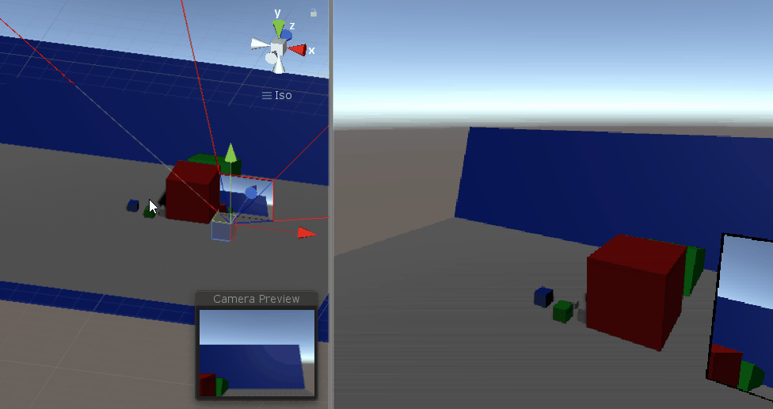
Example 3a See-through – fixed camera

Slide 29
Changing the camera and the image plane
Virtual element
1
WINDOW
World element
CAMERA POSITION
2

Slide 30
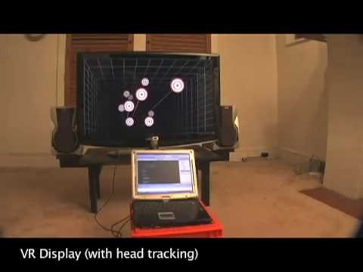
See-through – independent camera / fishtank
https://www.youtube.com/watch?v=Jd3-eiid-Uw

Slide 31
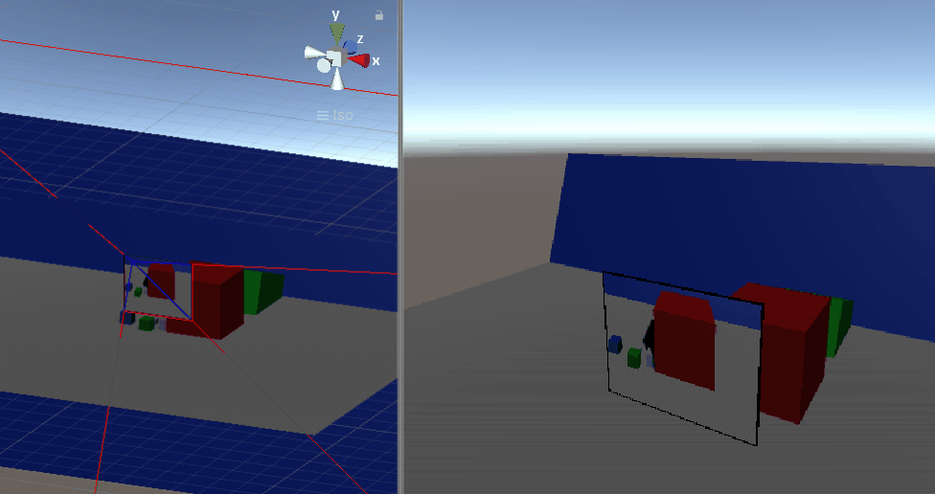
Example 3b See-through – independent camera

Slide 32
Understanding projectors

Slide 33
VIRTUAL CAMERA
(matching projector’s properties)
Augmentation
Image plane
Physical scene

Slide 34
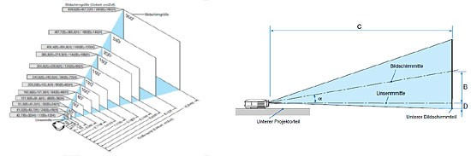
A projector is a reverse camera
But most of them are not symmetrical!
(vertical lens shift)
[Awful pictures]

Slide 35
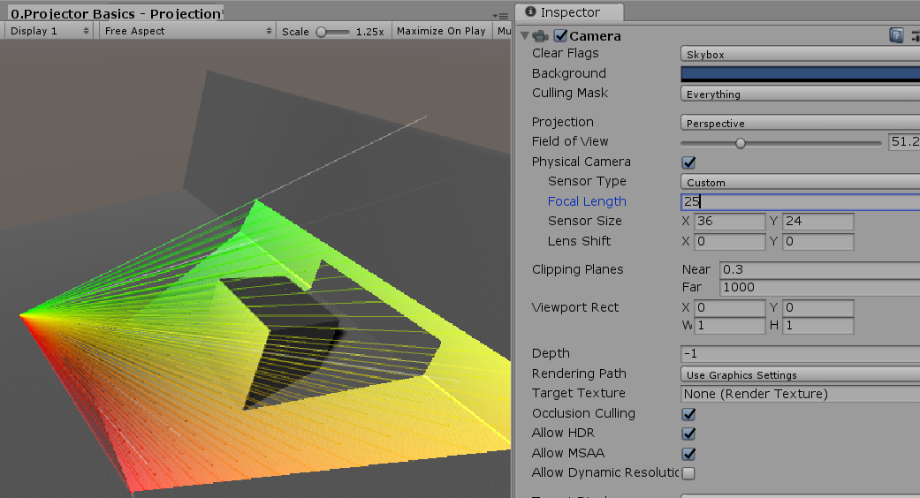
Example 0: Frustum

Slide 36
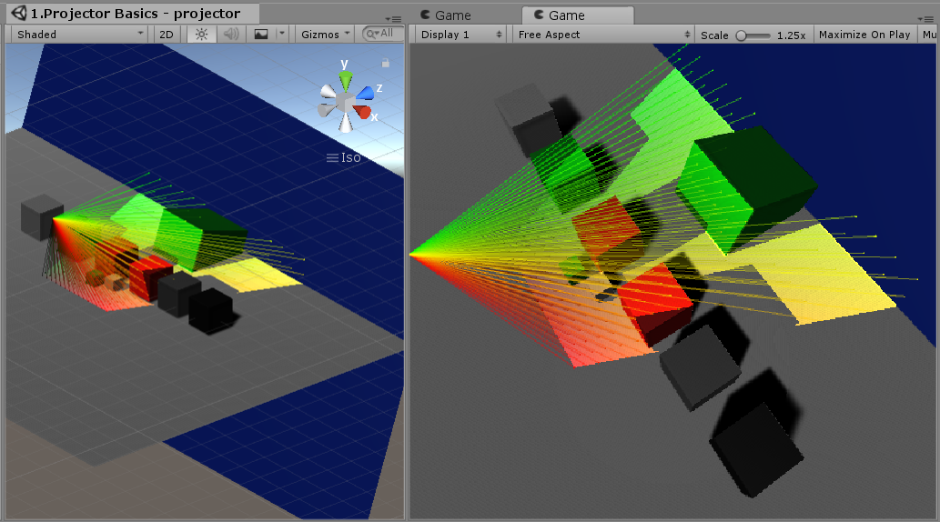
Example 1: materials

Slide 37
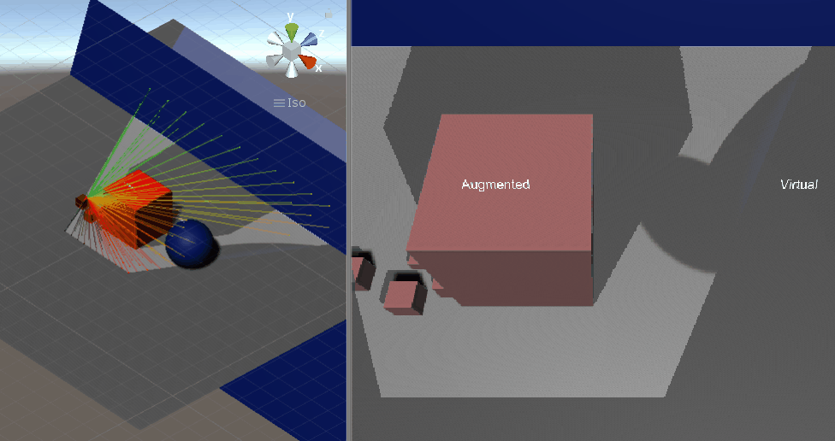
Example 3 Augmented surfaces vs virtual projection

Slide 38
CALIBRATING PROJECTORS

Slide 39
Example 0: Frustum

Slide 40
Calibration requires uv-xyz pairs
World element
(X,Y,Z)
(U,V)
(Optical center)
(image plane)

Slide 41
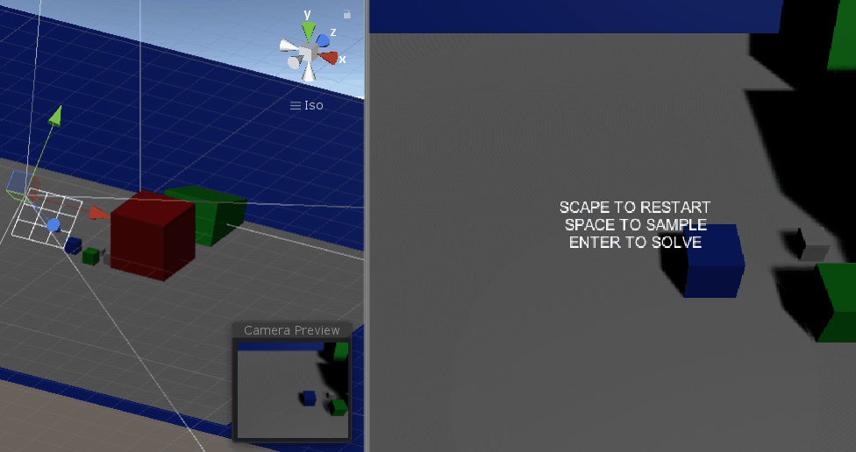
Example 4: Dummy calibration

Slide 42
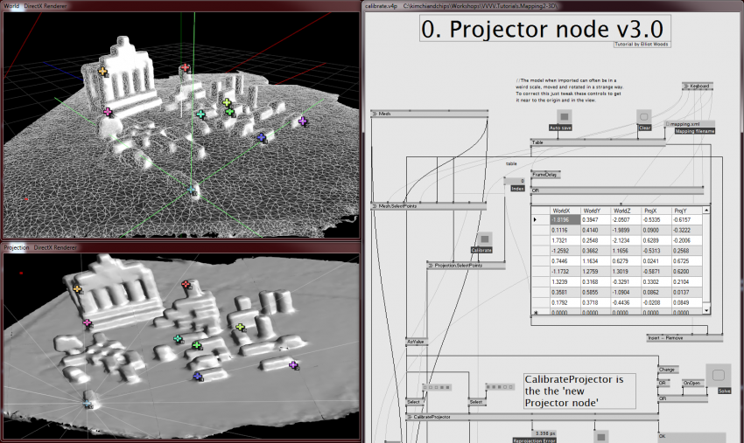
Example 5: UV Picking (bad)
Known virtual/physical 3D points
Manually pick the points in the projected plane
https://vvvv.org/contribution/vvvv.tutorials.mapping.3d

Slide 43
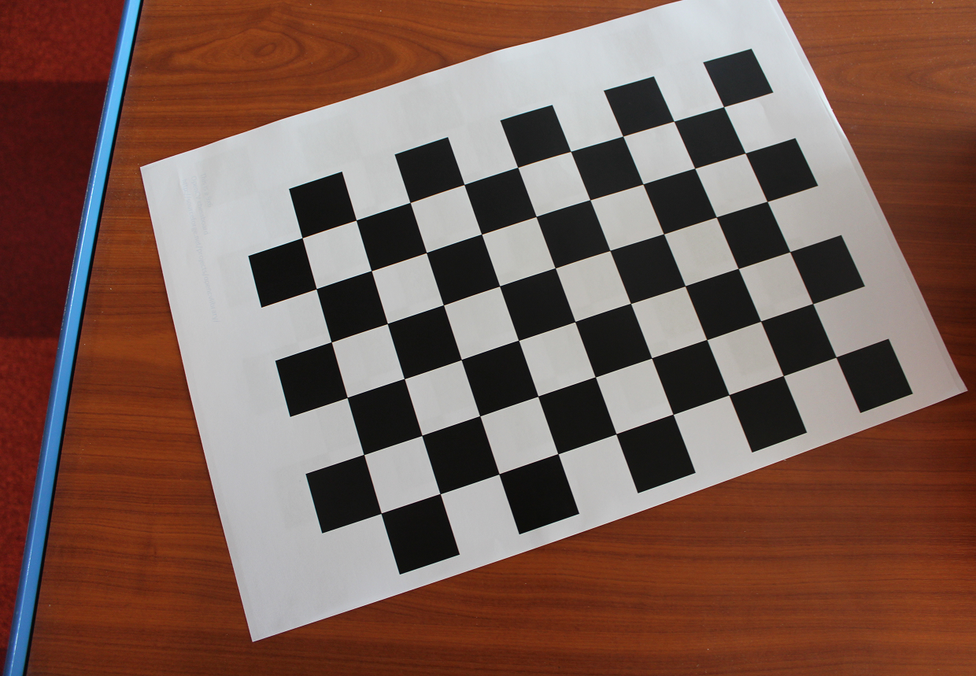
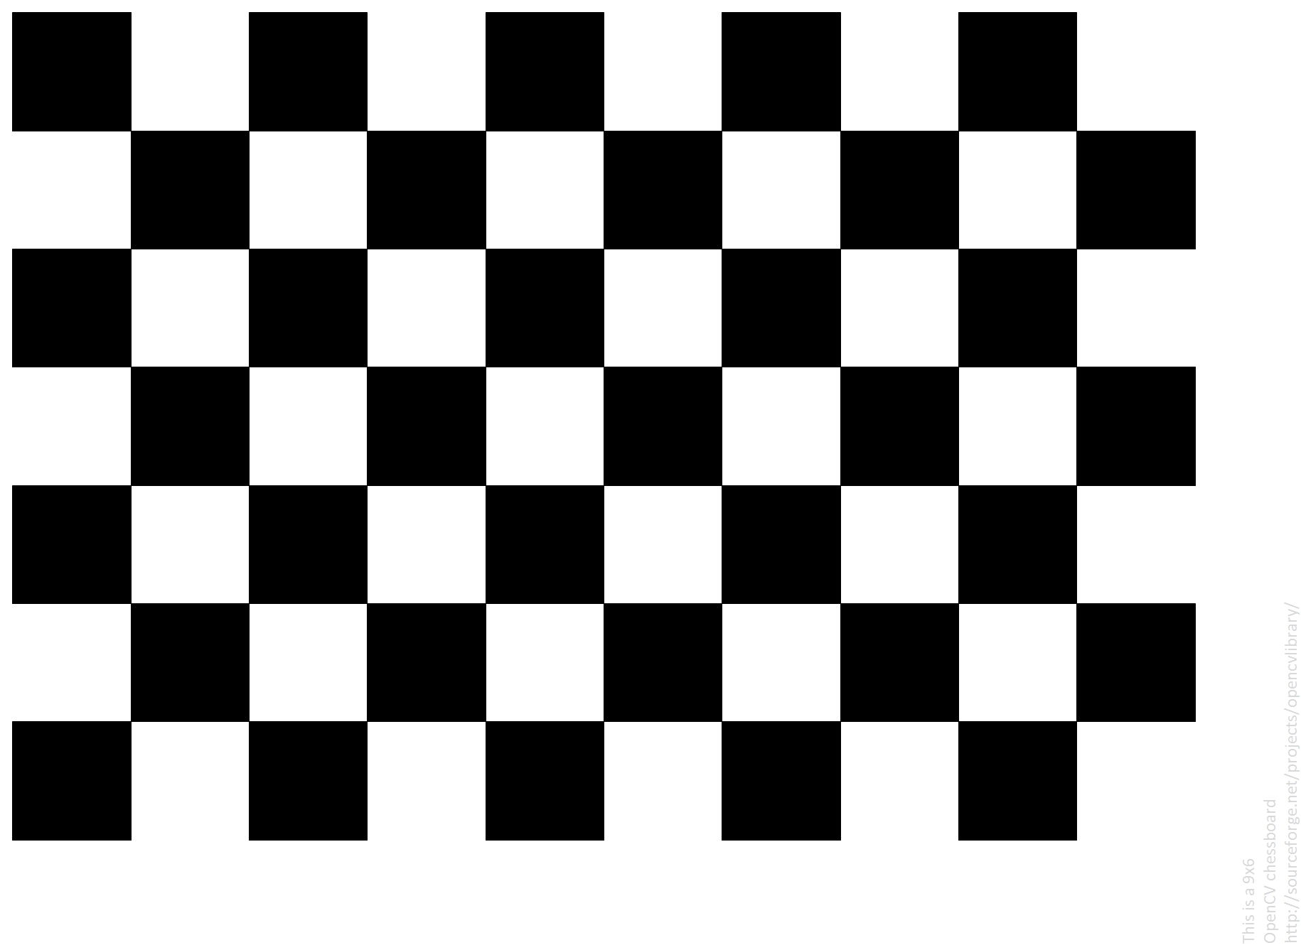
How checkerboards and markers provide 3D information
Width (cm)
Width (cm)
Height (cm)
Height (cm)
(X,Y,0)

Slide 44


AR Markers are just special grids
Height (cm)
(X,Y,0)
Width (cm)
Height (cm)

Slide 45
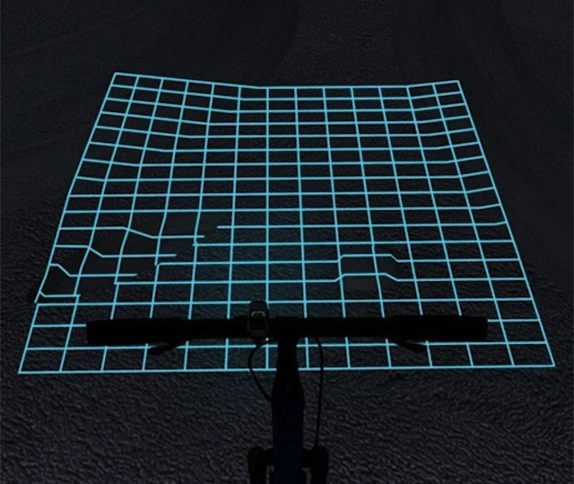
Example 5: Markers (decent/bad)
Known image points
Manually indicate xyz points using tracked object
Sorry no good images for this one

Slide 46
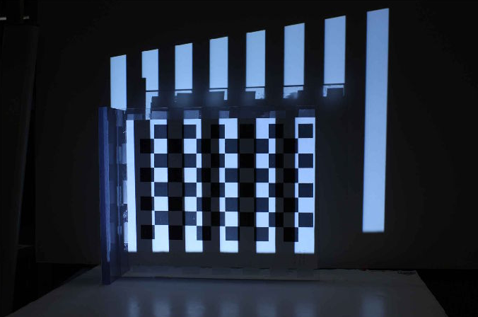
Example 5: Vision (decent /problematic)
Width (cm)
Height (cm)
Known virtual/physical 3D points
Structured light to find the uv coordinates
http://mesh.brown.edu/calibration/

Slide 47
Oveview
 | UV coordinates | World coordinates
UV picking | Manually picked | Preselected/known
Using markers | Picked / preselected | Indicated using tracked object
Using Vision | Structured light | Known object / 3d scanning

Slide 48

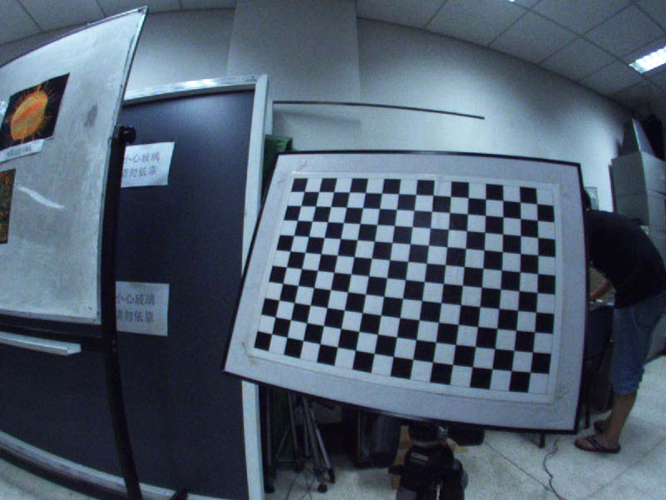
Image Distortion
Width (cm)
Height (cm)
(X,Y,0)
Width (cm)
Height (cm)

Slide 49
Image Distortion
y
y
y
y
x
x
x
x
No distortion
Radial distortion
(positive)
Radial distortion
(negative)
Tangential distortion
(x,y)

Slide 50
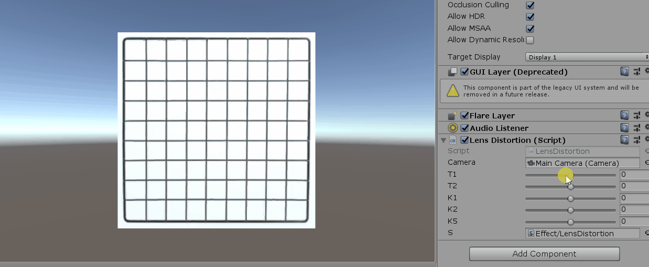
Example 8: Compensating camera distortion

Slide 51
Other stuff

Slide 52
HOMOGRAPHY (2D calibration)
Coordinate System
3D model
Picture
Calibration
Intrinsics
Extrinsics
4x4 matrix as Affine transform (rotation, translation scale and view perspective)
4x4 matrix (camera transform)⁻¹ as Affine transform (rotation, translation scale)
4x4 matrix
Object transform as affine transform (rotation, translation scale)
X Y Z
4x4 matrix normalized space to pixel, then divide by perspective
U, V (,Depth)
=
Image(2D*)
View(3d)
World(3d)
Local(3d)
PROVIDES GOOD SOLUTION OVER THE CALIBRATION PLANE
(but the solution is not valid outside that plane)
https://github.com/chiragraman/Unity3DProjectionMapping/blob/master/Assets/Scripts/Homography.cs
Opencv calibrate camera with 4 points gives an homography

Slide 53
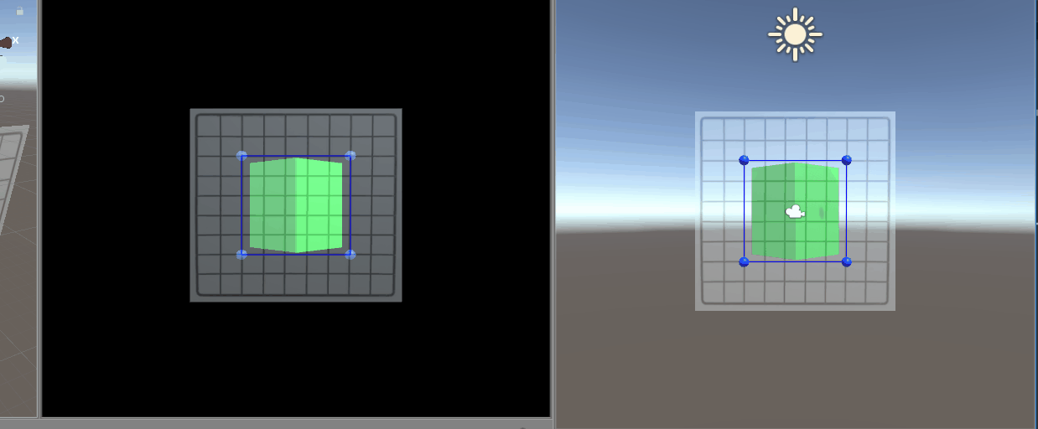
Example 9 Homography
Based on https://github.com/chiragraman/Unity3DProjectionMapping (but using cameras instead of shaders)

Slide 54
Video See-through
2
VIDEO FEED
Virtual element
World element
1
CAMERA
link to WINDOW

Slide 55
The end

